Slide 1
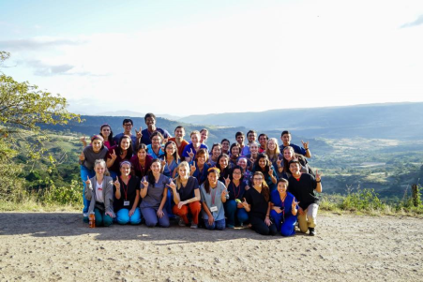
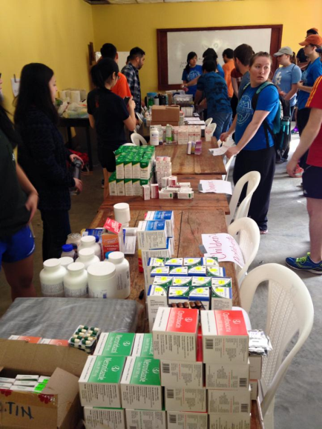
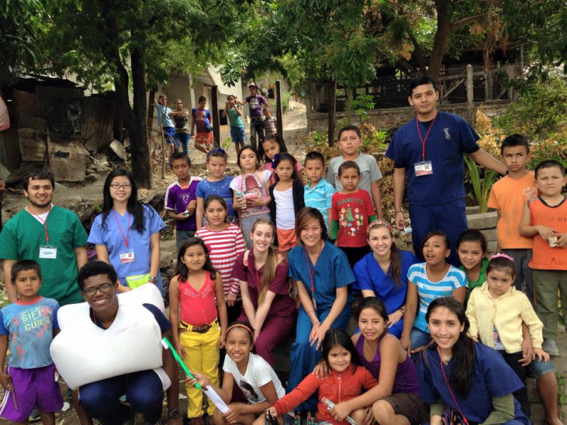
Donation Options for Global Medical Brigades
Main Supplies Needed
-Gloves
-acetaminophen(Tylenol)
-Aspirin
-vitamins (kids & adults)
Additional Items
-Excedrin
-Multisymptom cold relief
-charla supplies
-pens (sharpies too)
-scissors
-Tums
-omeprazole
-pregnancy tests
-toothbrushes
-hand sanitizeR
-duct tape
-floss
-scales
-paper towels
-dixie cups

